Slide 1

West Nile Virus (WNV)
Mosquito Test Results Analytics
WNV
Team 4
Shimanta Chakraborty
Metitiri Disi
Yue He
Gitesh Patil
Chen Wong
Instructor
Dr. Mahdi Moqri
Notes:
Image source: https://www.kttn.com/west-nile-virus-season-is-not-over-yet/

Slide 2

Agenda
Project Introduction
Database
Exploring Analytics
Predictive Analytics
Interesting insights
Future objectives

Slide 3
West Nile Virus (WNV) Mosquito Test Results
Introduction
History
Symptoms
Transformation
Importance of the topic
Impact
Ripple effect
Solutions
Analytics

Slide 4
About Data
The data is publicly available and accessible online by URL in a structured table in .csv file format:
https://data.cityofchicago.org/Health-Human-Services/West-Nile-Virus-WNV-Mosquito-Test-Results/jqe8-8r6s/data
Last Update: 26th Sep, 2019.
Time Period: 2007 to Present
Frequency: Data are updated daily
Rows: 29.5K
Columns: 18
“Result” - which indicates if the presence or absence of the WNV virus in a mosquito.
“Block” - which gives information on the locations of the traps.
“Species” - the information on the species of mosquitoes.
“Test Date” - more information on the time of the observation.

Slide 5
Issue to Data
Missing variables:
A total of 4410 observations had missing varaibles (7) under 10 major address locations (BLOCK).
Latitude, longitude and zip code identified from the address.
https://www.latlong.net/
No weather and temperature variables.
Variables still missing for certain ovservations:
Wards, Census Tracts, Community Areas & Historical Wards 2003-2015.

Slide 6
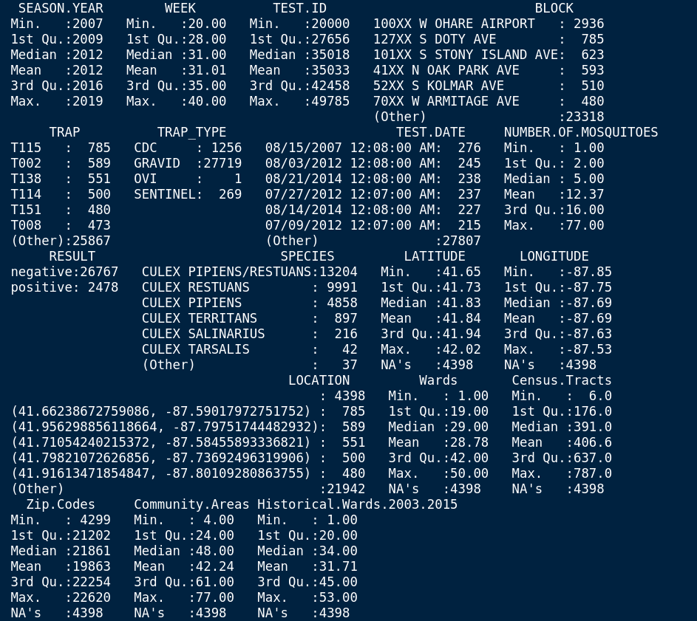

Exploring data
Statistics/Summary

Slide 7
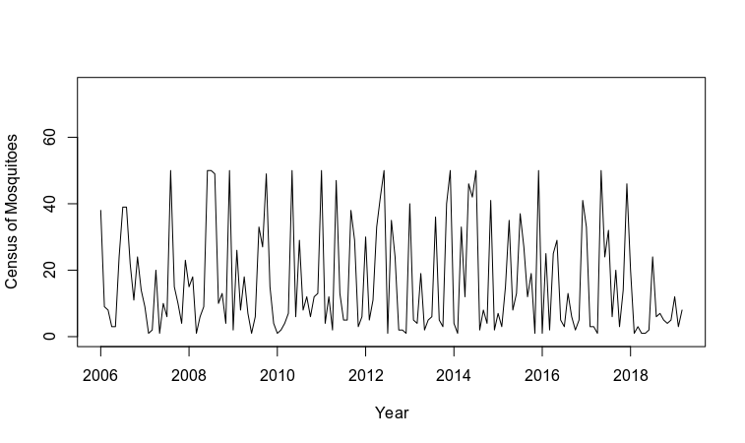
Exploring data
Chart: Time Series

Slide 8
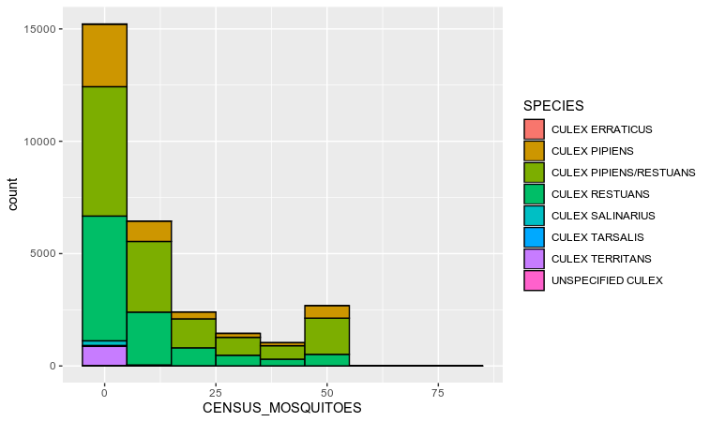
Exploring data
Chart: Histogram with Census of Mosquitoes as the variable and Species as a filter

Slide 9
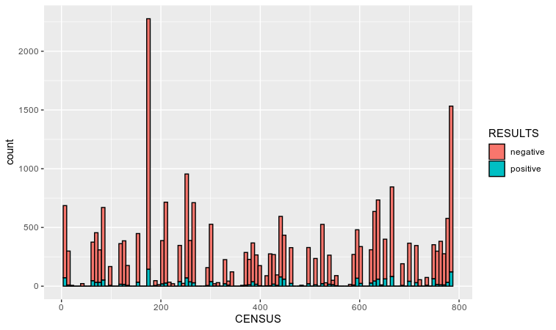
Exploring data
Chart: Human Census with Test results as filter

Slide 10
Predictive Analytics
Target Variables:
RESULT
Possible Predictors:
SEASON.YEAR, WEEK, TRAP_TYPE,
NUMBER.OF.MOSQUITOES,SPECIES
LONGITUDE,LATITUDE,LONGITUDE,
Wards, Census.Tracts,Zip.Codes,
Community.Areas,
Historical.Wards.2003.2015
Removed Variables:
TEST.ID - unique each row(0.99 cor with year)
BLOCK - specific address
TRAP - trap ID
Test.Date - test once a week
Location - combined Longitude and Latitude

Slide 11
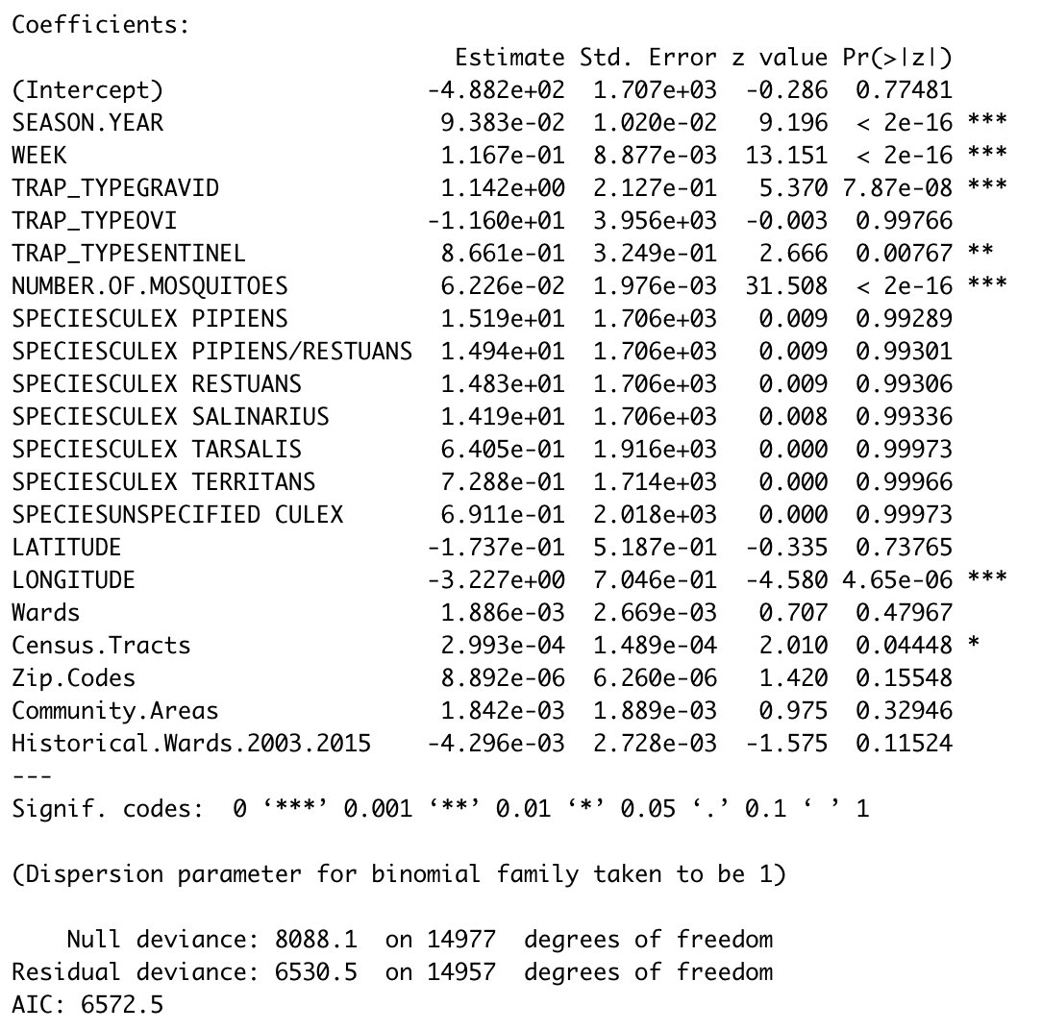
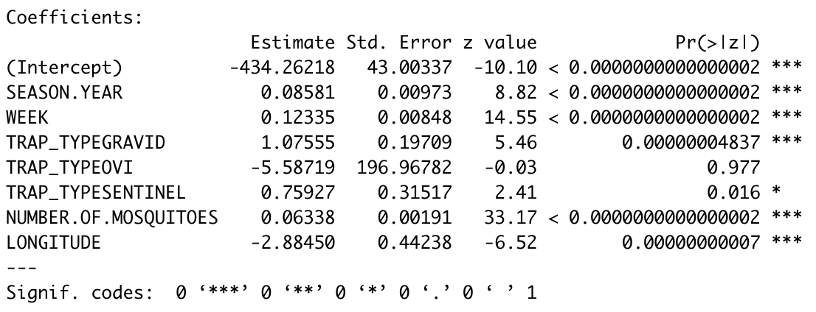
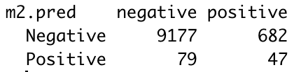
Predictive Analytics
Probability of Negative/Probability of Positive =
e^(- 434+0.09*SEASON.YEAR
+0.12*WEEK
+1.08*TRAP_TYPEGRAVID
- 5.88*TRAP_TYPEOVI
+ 0.76*TRAP_TYPESENTINEL
+ 0.06*NUMBER.OF.MOSQUITOES
- 2.88*LONGITUDE)
Actual
Accuracy= (9177+47) / (9177+682+79+47) = 0.9238
Overall Error Rate = (79+682)/ (9177+682+79+47) = 0.0762
Sensitivity = 9177 / (9177+79) = 0.9915
Specificity = 47 / (682+47) = 0.0645
Model

Slide 12
Interesting insight
Culex Pipiens and Restauns species are the highest mosquito population as well as highest positive WNV (~14% in 2018)
Gravid is the most used trap type
Location (longitude) is one of the predictor in our models, which raised the question: What make location a factor in spreading WMV? temperature? rainfall? ...
Notes:
Jonathan

Slide 13
Next Step...
Potential variable to add: precipitation amount by date in Chicago
Potential relation to investigate - Testing, location, and weather data to predict WHEN and WHERE different species mosquitoes will test positive WNV.
Importance of the results - A more accurate method of predicting outbreaks of West Nile virus in mosquitoes will help the City of Chicago and CPHD more efficiently and effectively allocate resources towards preventing transmission of this potentially deadly virus.
Notes:
Jonathan

Slide 14
Potential question to answer
What are the most prominent species?
What season (months/quarter) has the most number of mosquitoes? positive WNV mosquitoes to be specified?
Is weather/rain associated with the number of mosquitos?
Is temporature a drive factor for the mosquito population?
Can weather and area information be used to predict areas prone to infection and high time of infection?

Slide 15

Thanks…..
Any Questions?

